Slide 1
Zombie Zero
Technical Demo

Slide 2
Project Goals
Create a production ready game deployed online
Should be fun to play
No proof on concept, an actual game
Playable by everyone (Cross Platform)

Slide 3
Team Distribution
Muhammad Aniq Nasir
GitHub Profile
Worked on Core Game Logic, Core Game Systems …
Hasham Tanveer
GitHub Profile
Worked on Game UI, High Scores and Weapon Systems ...
Muhammad Mujtaba
GitHub Profile
Worked on Game Engine, Enemy Spawning ...

Slide 4
Game Overview
Genre
Top-Down Shooter
Objective
Clear all zombies in the city
Availability
Windows, MacOS, Linux*
*Linux executable is not available as of now, but gradle setup has been completed

Slide 5
Architecture Overview
Use Java as main Language
Uses JavaFX’s FXML & CSS for UI
Built using a Custom Game Engine using JavaFX
Architecture heavily inspired from Unity Game Engine
Consists of two separate independent modules; Engine & Game

Slide 6
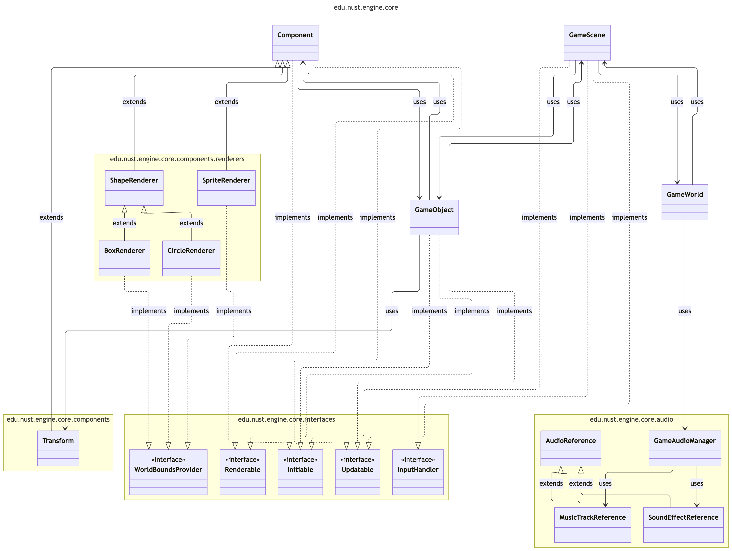
Engine High Level Overview
Start
Initialize
Start Game Loop
Hand Off to game module
End Game Loop
Clean Up
Exit

Slide 7
Index
Engine |  | Game Mechanics |  | Scenes Breakdown
GameWorld | 9 | Asset Manager | 33 | StartScene | 57
GameScene | 10 | Collision Manager | 34 | LevelScene | 58
GameObject | 15 | Player | 37 | HighScoresScene | 63
Component | 16 | Enemy | 40
Rendering Pipeline | 22 | Path finder | 45
Input Handling | 23 | Weapon System | 48
DevConsole | 24 | Health Bar | 52
Resources Management | 27 | Audio Management | 53
Math Library | 28 | Gradle Tasks | 54
GameLogger | 29 | UML Generation Pipeline | 55
Audio Management | 30

Slide 8
Engine
Deep Dive

Slide 9
GameWorld
GameWorld owns the JavaFX Stage and Scene
Drives the AnimationTimer loop for main Game Loop
Delegates each frame to the active GameScene
Switches scenes by swapping root children (world + UI)

Slide 10
GameScene
Represents a single scene in the game
Implements Initiable, Updatable
Owns the game object list, the world canvas, and the FXML UI
Has separate layers for GameObject rendering, UI Rendering, DevConsoleRendering
Abstracts input hooks from JavaFX into overridable methods.

Slide 11
GameScene (LifeCycle)
Init
Loads Mandatory layout.fxml from edu/nust/game/scenes/[CLASS_NAME]/layout.fxml
Loads Optional style.ss from edu/nust/game/scenes/[CLASS_NAME]/style.css
Initialize GameCamera
Initailize DevConsole
Setup Input Handler
Game Loop (Received from GameWorld)
Update self
Update GameObjects
LateUpdate self
LateUpdate GameObjects
Update Camera
Remove queued GameObjects
Render Objects In View
Render Debug Shapes

Slide 12
GameScene (LifeCycle)
Loads Mandatory layout.fxml from edu/nust/game/scenes/[CLASS_NAME]/layout.fxml
Loads Optional style.ss from edu/nust/game/scenes/[CLASS_NAME]/style.css
Initialize GameCamera
Initailize DevConsole
Setup Input Handler
Update self
Update GameObjects
LateUpdate self
LateUpdate GameObjects
Update Camera
Remove queued GameObjects
Render Objects In View
Render Debug Shapes

Slide 13
GameScene (GameCamera)
Can change camera zoom
Can follow a given position
For Movement the Canvas is moved, thus all GameObjects moves when camera is moved
Can Shake
Depends upon given intensity
Consecutive calls increase shake intensity
Working
Stores 2 positions (actual position and render position)

Slide 14
GameScene (Render Order And Culling)
Objects are sorted by renderLayer and culled by camera bounds.
Object bounds are provided by renderer components using WorldBoundsProvider interface
renderLayer by default is 0, if two objects has same renderLayer, then the one added last takes precedence for rendering

Slide 15
GameScene (Debug Rendering)
Grid, mouse location, and timed/frame debug shapes can be rendered on the world canvas on top of all gameobjects.
Grid renders a grid, was used in blank scenes when scene background hadn’t created
Mouse Location shows a red crosshair at the mouse, highlighting the world coordinates of that point
Timed shapes stored in a set and cleared after the given TimeSpan
Frame-only shapes cleared each frame

Slide 16
GameObject
Represents any and all objects in the game
Implements Initiable, Updatable and Renderable
Can be added or removed at runtime
Composes of Components with their own lifecycle
Can have multiple Tags
A Tag is simply a class extending the Tag class, the class itself is used as a tag rather than a string

Slide 17
Component
Represents behavior of a GameObject
Implements Initiable, Updatable and Renderable
Can be added or removed at runtime
Can be added to multiple different GameObjects, but only one instance can exist on a GameObject at a given time

Slide 18
Component (Transform - Pre Existing)
Guaranteed to be present on any GameObject
Used to represent position, rotation and anchor of this object
Anchor can be set using a Vector2D, predefined helpers for setting anchor to center, top left, bottom, center etc.

Slide 19
Component (Transform - Pre Existing)
Guaranteed to be present on any GameObject
Used to represent position, rotation and anchor of this object
Anchor can be set using a Vector2D, predefined helpers for setting anchor to center, top left, bottom, center etc.

Slide 20
Component (BoxRenderer - Pre Existing)
Renders a Box with the given size
Position is fetched from Transform component of attached GameObject
Can be rotated as well
Is affected by anchor positioning
Can be filled, stroked
Corner radius can be applied
Properties can be changed at runtime

Slide 21
Component (CircleRenderer - Pre Existing)
Renders a circle with the given radius
Position is fetched from Transform component of attached GameObject
Is affected by anchor positioning
Can be filled, stroked
Properties can be changed at runtime

Slide 22
Component (SpriteRenderer - Pre Existing)
Draws a sprite or sprite sheet with the given frame counts
Position is fetched from Transform component of attached GameObject
Can be rotated and affected by anchor positioning
Supports tint and opacity
Supports Animation by setting animation time, after the given time the frame is automatically changed
Can be flipped
Properties can be changed at runtime

Slide 23
Rendering Pipeline
Handled by GameScene
worldLayer is a Canvas
Renders GameObjects
uiLayer loaded from FXML and CSS
Renders JavaFX nodes
consoleLayer stacked on top
Renders DevConsole, above everything

Slide 24
Input Handling
Handled in GameScene by overriding methods given in InputHandler interface
Has the following events
onKeyPressed
onKeyReleased
onMousedPressed
onMouseReleased
onMouseMoved
onMouseDragged

Slide 25
DevConsole
Can be opened in any scene by pressing “Shift + `”, and exit by pressing “Esc”
Commands to modify game behaviour at runtime
Supports suggestions and history
Displays the following stats
Game FPS
Total Objects added
Objects being Rendered (objects not visible are culled)

Slide 26
DevConsole (Command)
Commands stored in a map with normalized names
Executors return strings shown in console output
Every GameScene can register commands that can be executed in that scene
Shows suggestion with command usage realtime, can press tab to autocomplete the command
Preserves History of Previously Executed Commands in this session
Show output of previos commands as well

Slide 27
DevConsole (Default Commands)
/help
Shows Registered Commands
/debugGrid [true|false|number|empty]
Toggle grid, with given size if number specified
/debugMouseLocation [true|false|empty]
Toggle world mouse crosshair + coordinates.
/setCameraZoom [number]
Set camera zoom
/toggleUI [true|false|empty]
Toggle FXML UI visibility (excluding dev console).

Slide 28
Resources Management (Resources)
Path for resouces are resolved relative to /edu/nust/game/ in resources directory
resources directory is bundled with the executable by Java
Supports optional Resources and mandatory resources by tryGetResource(...) and getResourceOrThrow(...) respectively
Utility for loading a JavaFX Image from the given path, assumes loading image is mandatory
Used extensively to get every kind of resource including, text, image, or any other type

Slide 29
Math Library
Vector2D
A container for 2 numbers
Used to represent positions, velocities etc.
D stands for double, represents the data type used for storing numbers
TimeSpan
Used to represent a said amount of time
Used instead of int, double etc. to remove confusion regarding unit of time
Constructor is privatized, instead factory methods are used that explicitly mention the unit, e.g TimeSpan.fromSeconds(10).
Getting the time value also require explicit unit e.g. deltaTime.asMilliseconds()
Has methods for interconversion between units ranging from nanosecond to day
Internally stores the time in the form of nanoseconds
Rectangle
Used to represent an area covered by a Rectangle
Is Axis Aligned, i.e. cannot be rotated
Can be shrunk and grown
Queries for intersection between rectangles, containing a given point etc.
Angle
Used to represent a certain angle
Constructor is privatized, instead factory methods are used that explicitly mention the unit, e.g Angle.fromDegrees(10).
Getting the time value also require explicit unit e.g. rotation.getRadians()
Has methods for interconversion between radians and degrees

Slide 30
GameLogger
Wraps SLF4J Logger
Writes each log to its own file
Logs can be filtered by one global level
Level Types in order:
Trace
Represent calls to visually trace the program
Debug
Intended for debug
Info
Default Log Type
Success
Represents any successful operation
Warn
Intended for warnings
Can throw or not based on user preference
LogProgress
Represents a progress that can be
Gives color to the prefix
Archives the old logs based on timestamp
Error
Started, Reported, Ended

Slide 31
Audio Management
AudioReference stores the audio URL and common metadata
Created internally by GameAudioManager of GameScene
Two Types
SoundEffectReference
Represents short bursts of sounds like bullet shots etc.
Cannot be paused or have granular control, but can have overlapping instances of same reference
Uses JavaFX Clip internally
MusicTrackReference
Represents long sounds, musics mainly
Can be paused and has granular control, but cannot have overlapping instances of same reference
Uses JavaFX MediaPlayer internally

Slide 32
Audio Management (GameAudioManager)
Manages all in-game audio
Can load and unload an AudioReference
Controls Global Volume for muting, same global volume for both Effects and Tracks
Linked to the GameWorld
Loaded Effects are only unloaded when game exits
AudioReferences persists when switching scenes
All loaded references are cached by full relative path; loading the same asset twice returns the existing reference
All paths are resolved relative to edu/nust/game/assets/audio/

Slide 33
Game Mechanics
Deep Dive

Slide 34
Asset Manager
Singleton that loads assets once and reuses them
Uses an enum interface for Asset Type
Has a cache of loaded images
Used to loads images for character, enemy and boss etc.

Slide 35
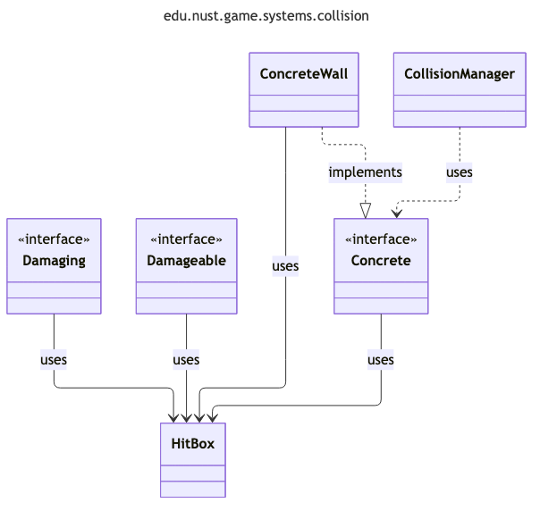
Collision Manager
Collects Damageable, Damaging, and Concrete objects and resolves collisions
Two types of Collision
Concrete (Concrete Objects & Concrete Objects)
Damaging (Damaging Objects & Damageable Objects)
Notifies the objects that the collision has occurred with reference to other

Slide 36
Collision Manager (Interactions)
Stops bullets (Bullets collision with walls), Player movement restrictions (Concrete & Concrete)
When Bullet hits enemy, increase the follow radius of the enemy (Damaging & Damageable)
Award kill score when an enemy dies
Separate for each enemy type

Slide 37
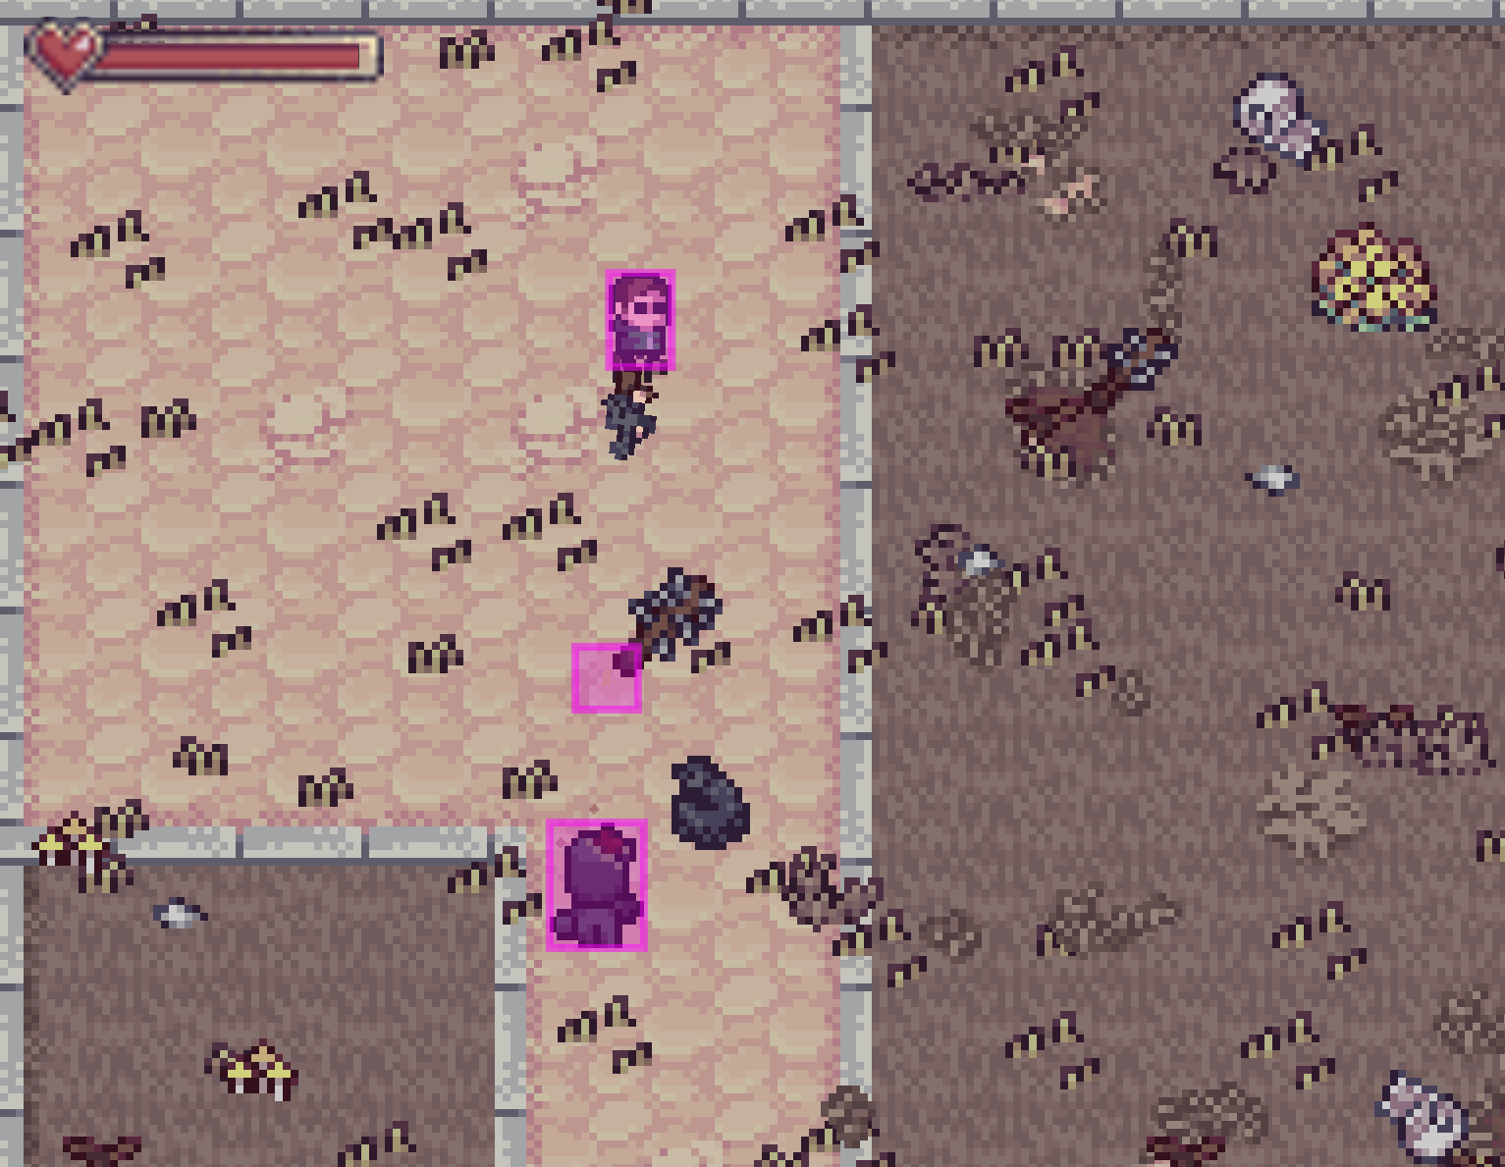
Collision Manager (Hitbox)
Performs AABB collision checks
AABB: Axis Aligned Bounding Box
Supports debug visualization
Method for collision with each sides of the AABB rectangle
Player Hitbox is a bit smaller
Bullet and Enemy Hitbox intentionally enlarged

Slide 38
Player
Extends Character and Implements Damageable and Concrete
Movement speed: 50 units/sec
Takes input from WASD and Arrow keys
Injects a walkabilityChecker backed by the level's collision mask for movement validation
Camera follows the player's position every frame in lateUpdate()

Slide 39
Player (Animation)
Sprite sheets
Idle
Run in 4 directions
Animated at 75ms per frame
Direction is determined from the movement delta each frame
Idle animation plays when no input is held

Slide 40
Player (Health)
Health is a separate class shared by both player and enemies
Tracks current and max health
Red tint is blended onto the sprite as HP drops
tintStrength = (1.0 − healthRatio) × 0.5
HitBox is smaller than visual sprite

Slide 41
Enemy (Abstract)
Implements Concrete and Damageable
Subclasses must have methods for attacking and animations
Per-frame state machine
if dead → play death animation
if player out of range → idle/melee
if in range → pathfind and move
Path re-computed every 300ms via PathFinder
Default follow range is 200 units
When a bullet hits, follow range doubles

Slide 42
Enemy (Base Enemy)
Extends Enemy class
Standard Enemy spawned across the map
Spawns a BasicAttackObj on melee
Hitbox at current location lasting 400ms
Death
plays 6-frame death sheet
then opacity decrease at the rate of−0.05 per frame until 0
then destroys itself

Slide 43
Enemy (MiniBoss)
Extends Enemy class
Spawns at bottom middle of the first section of level
Has 2 attacks
Standard melee
Ranged axe throw
Axe throw
Range 300 units
Spawn

Slide 44
Enemy (Boss)
Extends Enemy class
Spawns at top right of the second section at the end of the level
Same base stats as MiniBoss
Upgraded version of the MiniBoss
Has a twist (~Spoilers)

Slide 45
Enemy (Health)
Health is a separate class shared by both player and enemies
Tracks current and max health
Red tint is blended onto the sprite as HP drops
tintStrength = (1.0 − healthRatio) × 0.5
HitBox is smaller than visual sprite

Slide 46
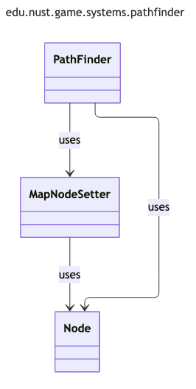
Path finder (Initialization)
Uses MapNodeSetter class
First creates a grid of nodes using native fixed size 2D array in MapNodeSetter
Loops over the the Level Collision Mask to determine walkable area
A* search ready to calculate path from any given point to another one

Slide 47
Path finder (A*)
Nodes:
Nodes are points on the grid.
Each node has gcost,hcost and fcost.
Each node can be open (open for evaluation), checked, solid or can be start or goal node
gCost is the distance of node from the start node
hCost is the distance of node from Goal Node
fCost is the sum of hCost and fCost

Slide 48
Path finder (A*)
First sets up the start (Enemy Position) and the goal node (Player Position)
From the start node (setting it as current node) it evaluates its adjacent nodes and adds them to the open List (Queue with fcost as its comparator, i.e constructs a list with smaller fCost at the top)
Setups the gCost ,hCost and fCost of the nodes
Set current node to be the first element of priorityQueue (the node with least amount of fcost)
Check the current node and evaluates its neighbours.
Neighbour is only be added to open list if it is not start node, not solid node, not already a open node or it has greater gCost than the current node’s gcost+1
If a neighbouring node is added to the openList its parent is set as current node for which it was evaluated.
Now it continues this till it reaches the goal or does not find the goal within 3000 iterations.
To return the path we trace back using the parent nodes. If no path was found empty list/path is returned.

Slide 49
Weapon System (Weapon)
Added to the scene alongside the player as a GameObject
Orbits the player at a fixed offset, aimed toward the mouse cursor
Sprite flips vertically when aiming left (angle > 90°)
Uses a 6-frame idle sprite sheet with animation
Plays a 3-frame muzzle flash rendered at the barrel tip on fire
Supports auto-fire (hold mouse button)
fireWeapon() is called every frame; enforces fire rate via a cooldown (1 / fireRate seconds per shot)

Slide 50
Weapon System (Ammo)
Ammo is a standalone class (not a Component) owned by Weapon
Max ammo is 30
Decremented by 1 per shot; automatically triggers reload when it reaches 0
Manual reload can also be triggered via the R key
Reload has two phases: a 0.5s delay, then a 2.0s fill
During reload, firing is blocked

Slide 51
Weapon System (Bullet)
Bullet is a GameObject implementing Damaging and Concrete
Spawned at the player center position, directed toward the mouse
Travels at a speed of 250 units/second; has a max range of 1000 units
Destroys itself when out of range
Carries a damage value set by Weapon
Implements triggerCollisionEffect()
Play a random impact sound
Spawns a BulletImpact particle (50% of the time)
Then destroys itself
Will not damage Player

Slide 52
Weapon System (UI)
AmmoBar is a JavaFX HBox placed in the FXML UI layer
Displays 10 bullet icon slots; each slot represents 3 rounds (30 max / 10 slots)
Each slot shows either a filled or empty bullet sprite (bullet.png / bullet_empty.png)
IMAGE: Ammo Bar Image

Slide 53
Health Bar
JavaFX UI Node that is rendered in the FXML UI layer
Extends Bar; provides a slider than can be filled by a given amount
Renders HP-Bar.png as a frame and crops HP.png fill by the current health ratio
Crop width shrinks as health decreases

Slide 54
Audio Management In Game
Audios
Exposes methods for sound effects and music refrences
Randomized sound effect selection
Usage: Audios.clickNeutralRef().ifPresent(SoundEffectReference::play)
MusicManager
Uses Music references from Audios
Transitions to the music of the given scene
Does by fading out the old one, and fading in the new one

Slide 55
Gradle Tasks
packageWindows
Packages into an exe installer
packageMac
Packages into an dmg installer
packageLinux
Packages into linux installer
buildExecutableJar
Builds a jar that can be opened by JRE
run
Runs the application with full logging (Maxiumum log level defined in Main class)
runNoLogs
Runs the application with no logging
runTestLogger
Runs a test that tests the logger of all formats, error message etc

Slide 56
UML Generation Pipeline (Misc.)
Requires Python & Mermaid CLI in npm
Generate UML using a python script
Uses mermaid for to scaffold structure, then renders using the mermaid renderer
AI Generation Disclosure

Slide 57
Scenes
Breakdown of each scene

Slide 58
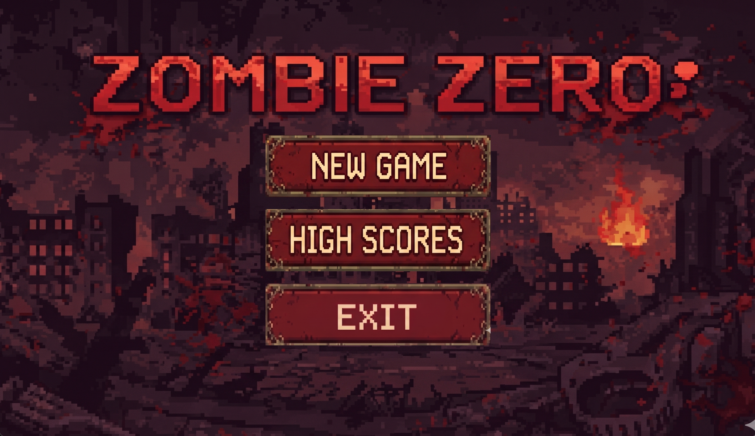
Start Scene
Main entry point of the game
Routes to main game and high scores along with exit game button

Slide 59
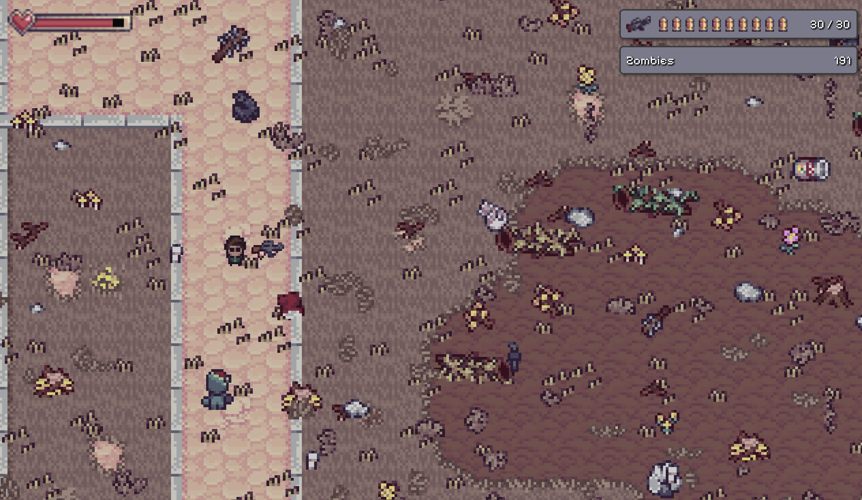
Level Scene
The main level of the game
Objective is to clear out all zombies

Slide 60
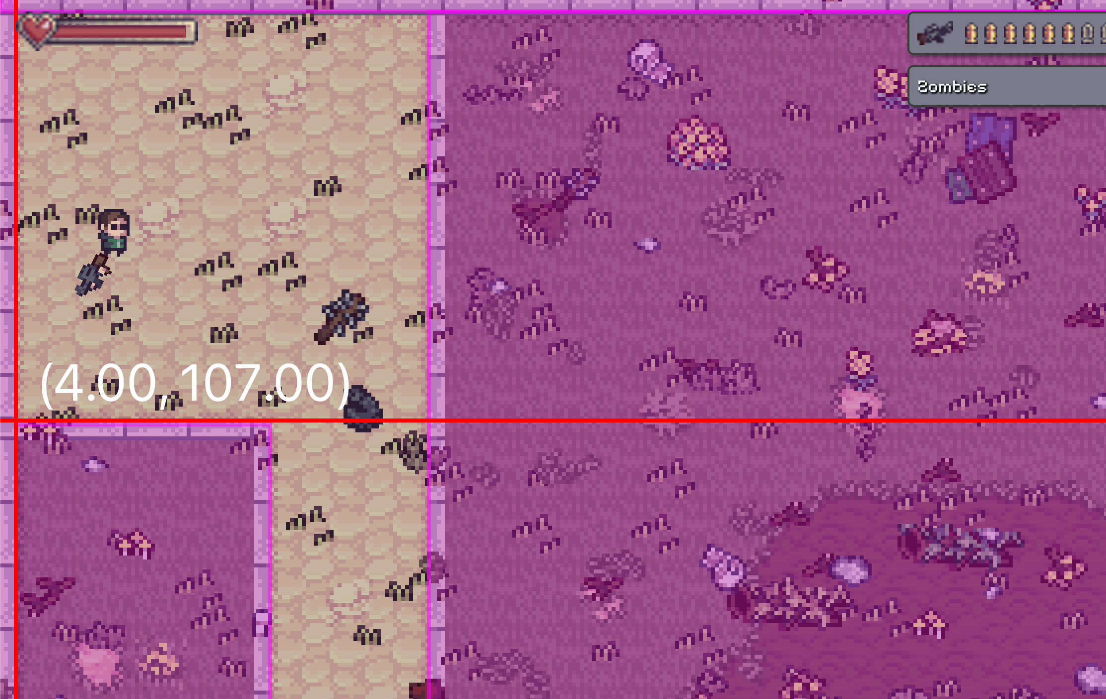
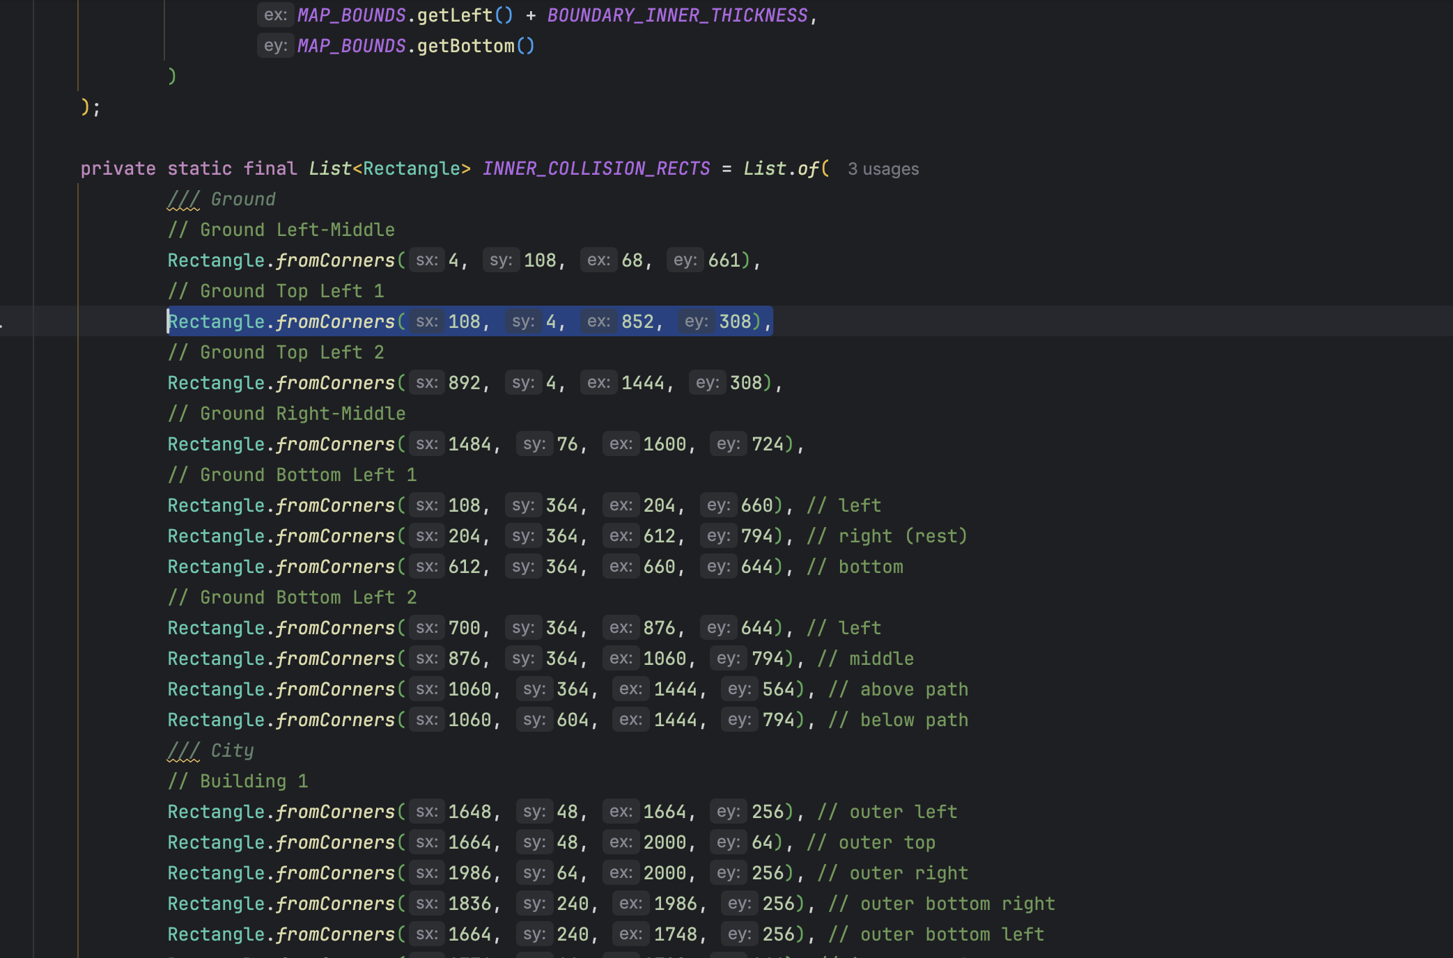
Level Scene (Collision Mask)
Defines a list of rectangles that are used to defined unwalkable areas

Slide 61
Level Scene (Enemy Spawning)
Spawns when the game is loaded
Generates spawn points across a grid with random offsets and validation.
Avoids non-spawnable area
Validates with collision mask and movement checks

Slide 62
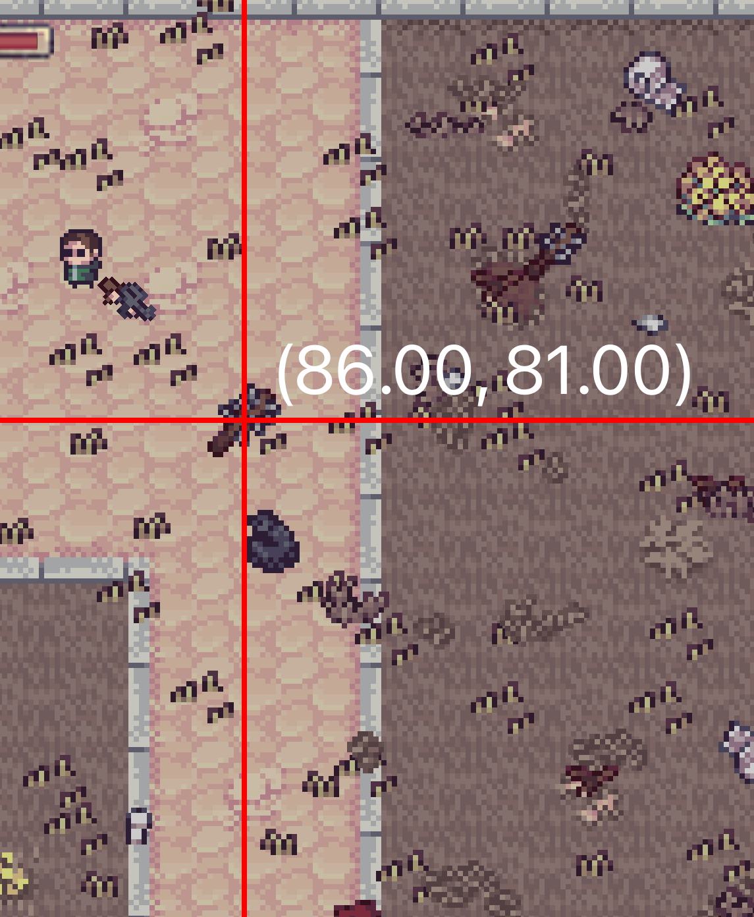
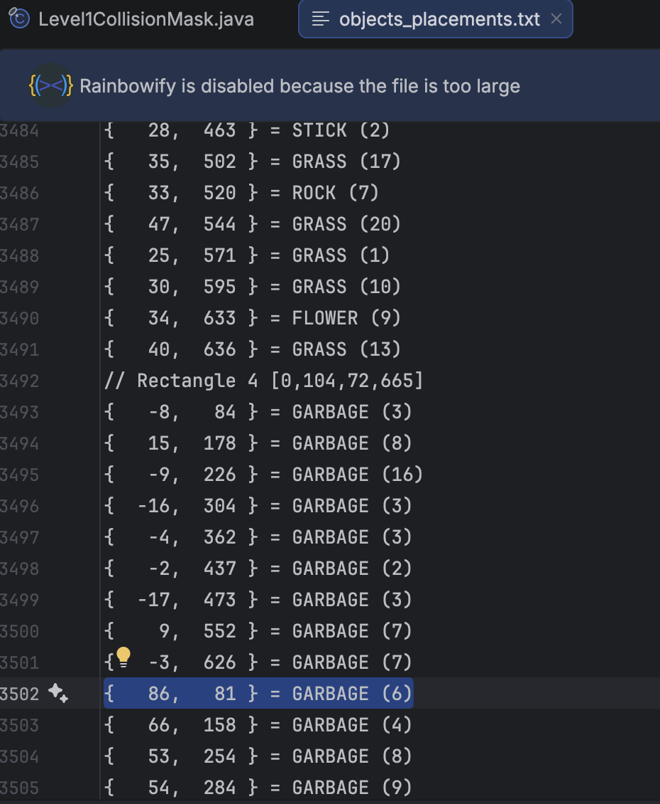
Level Scene (Objects placement)
Static objects are loaded from objects_placements.txt and added to the scene
objects_placements.txt generated once in development

Slide 63
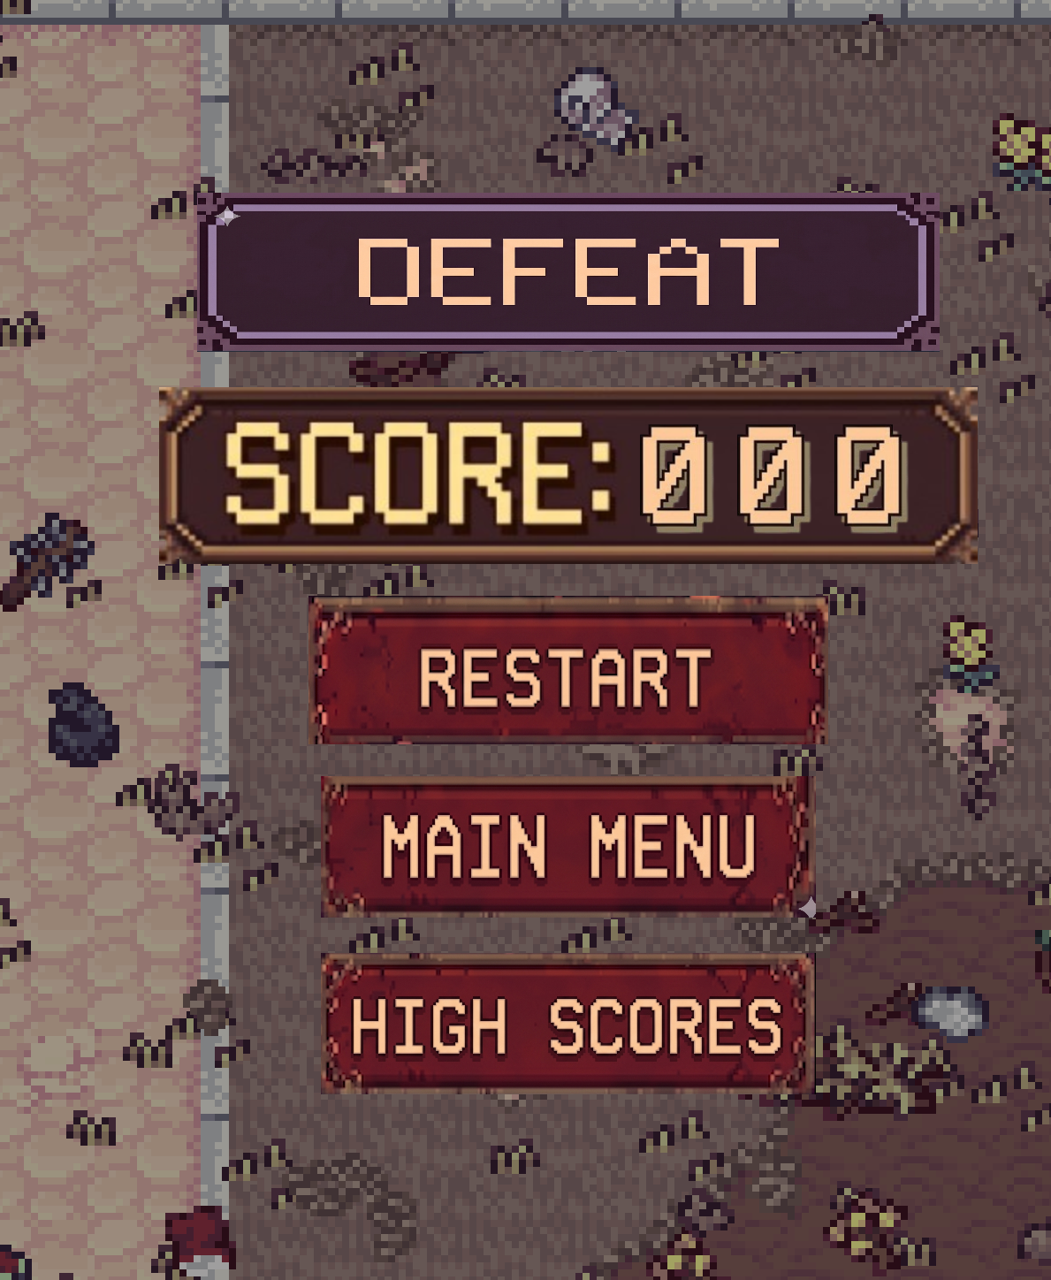
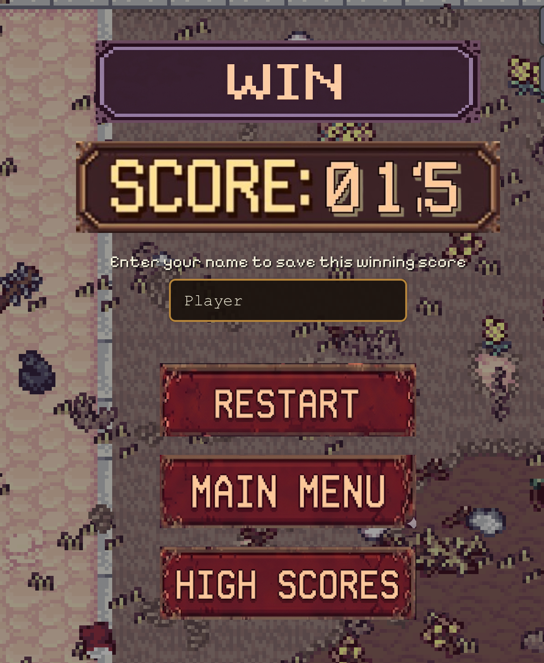
Level Scene (Win and Lose Screen)
Displays score as 3-digit number (7 displays as 007)
Uses a spritesheet for the number font

Slide 64
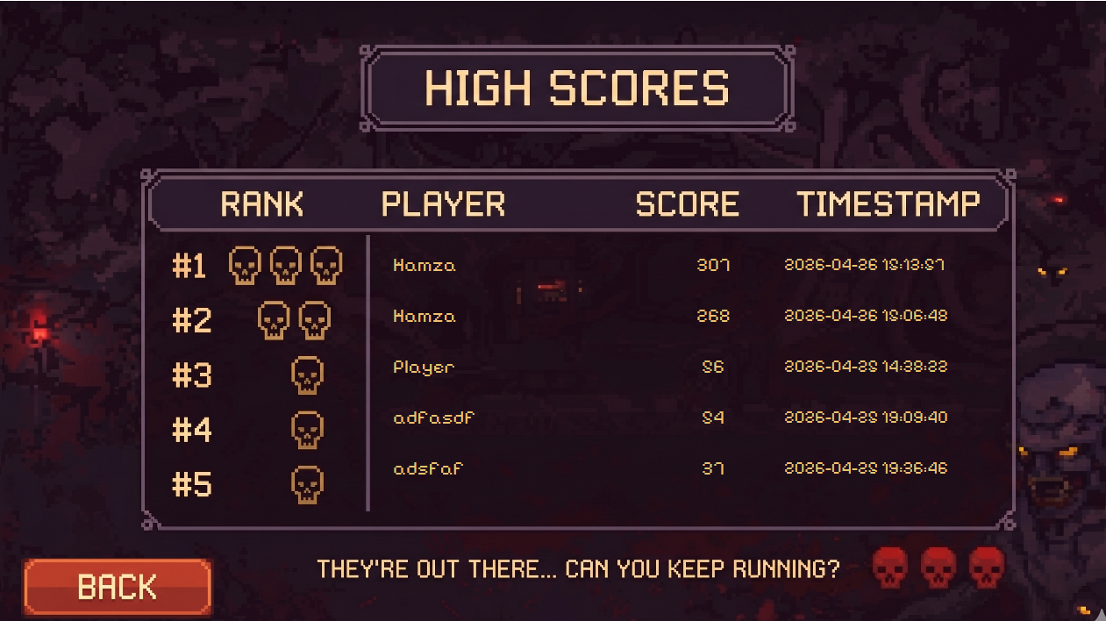
High Scores Scene
Shows the high scores fetched from highscores.txt
Loads and renders top 5 scores within a list.

Slide 65
High Scores Scene (Storage)
Stored in csv like format in highscore.txt
Name of current player stored in PlayerSession
Scoring breakdown:
1 point every 5 seconds
3 for regular zombies
8 for miniboss
15 for boss

Slide 66
OOP Concepts Used
SOLID & other principles

Slide 67
SOLID (Single Responsibility Principle)
Resources only resolves and loads assets.
Score only tracks score state and time-based increments.
Health holds current/max HP and ratio logic.
HealthBar renders health bar by a given.
CollisionManager detects collisions and calls Health.takeDamage(x); it does not know how UI renders health.

Slide 68
SOLID (Open Closed Principle)
New behaviors can be added by creating Component subclasses without changing Component itself.
New scenes extend GameScene without altering engine code.
BasicEnemy, MiniBoss, and Boss all extend Enemy without modifying any enemy base logic.

Slide 69
SOLID (Liskov Substitution Principle)
GameScene.addGameObject(GameObject) accepts any subclass (Player, Weapon, Bullet).
CollisionManager holds lists of Damageable and Damaging — any Player or Enemy subclass can be passed without the manager needing to know the concrete type.

Slide 70
SOLID (Interface Segregation)
Initiable, Updatable, Renderable, InputHandler are separated.
GameObject implement Initiable, Updatable, Renderable but not InputHandler.
Similarly, GameScenes implement Initiable, Updatable, InputHandler but not Renderable
Bullet implements only Damaging and Concrete; it is never forced to implement Damageable since bullets cannot receive damage.

Slide 71
SOLID (Dependency Inversion Principle)
GameScene’s culling uses WorldBoundsProvider interface, decoupling from concrete renderers.
CollisionManager depends entirely on the Damageable, Damaging, and Concrete interfaces — it never imports Player, Enemy, or Bullet directly.

Slide 72
Composition & Aggregation
GameScene composes GameCamera
Destroying GameScene destroys GameCamera
GameWorld Aggregates GameScene
Scenes can exist after destroying GameWorld

Slide 73
Abstraction:
Component (Abstract Base Class)
Defines common interface for all components
Implements lifecycle methods (init, update, render)
Provides logger and GameObject reference
Usage:
Transform
BoxRenderer
CircleRenderer
SpriteRenderer
Hides unnecessary implementation details and
exposes only the essential features of an object.

Slide 74
Singleton:
AssetManager (Singleton)
Single static instance
Synchronized getInstance() method
Caches loaded images
Prevents duplicate asset loading
Ensures a class has exactly one instance
throughout the application and provides a global access point to that instance.

Slide 75
Facade:
Audios (Static Facade)
Simplifies access to GameAudioManager
Organizes sound references by category
Handles random selection for variations
Provides convenient static methods
Provides a simplified, unified interface to a
complex subsystem or set of interfaces

Slide 76
Conclusion
Final Remarks

Slide 77
Technical Challenges
How to convert the map to a grid and the path obtained from grid back to map coordinates?
How to place thousands of objects in a single scene?
How to loop the music so that it never ends?

Slide 78
Future Roadmap
Add more levels
Add More Bosses
Add Lore
Add Campaign
Add Multiplayer
Improve Game Engine Versatility
Improve Enemy AI
Improve UI
Improve Game Design

Slide 79


Thank You!
Game
Try It OUT!
Source (Github)

Slide 80

Q & A
Slides
Any questions, if so, feel free to ask?

